Slide 1






Lecture 20:
React Features I
Course - Web Development - II
-By
Instructor Name
welcome@krmangalam.edu.in
Sohna Road,Gurugram,Haryana 122103

Slide 2

| Table of Contents
Virtual DOM vs. Real DOM.
Reconciliation
SPA
JSX Syntax & Expressions.
References.
The End.

Slide 3
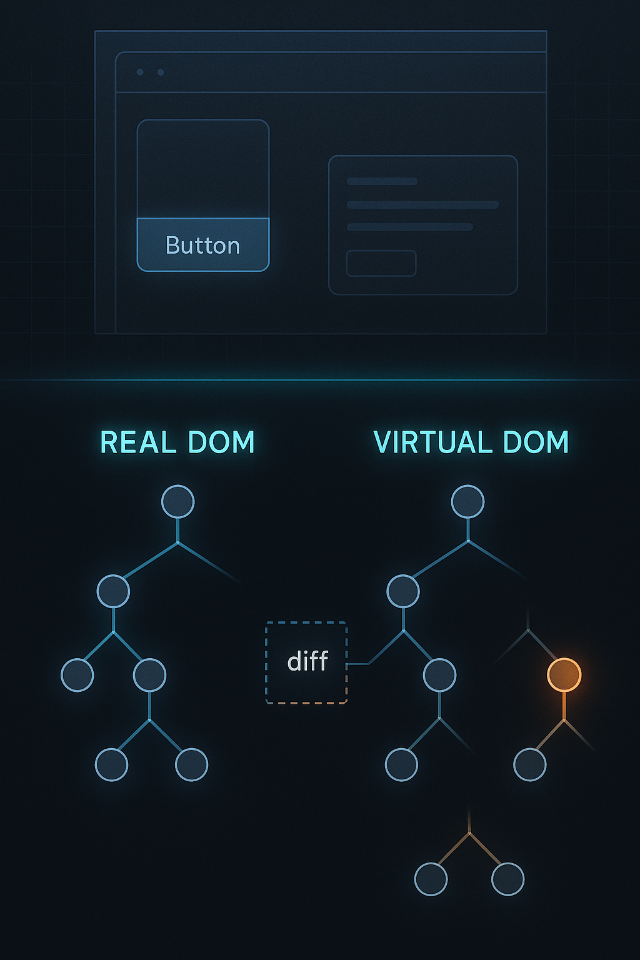
|
What would happen if you remodeled(Rebuild) the entire room for every small change?
It would be time-consuming, inefficient, and exhausting — like reloading the entire web page for one small UI change.
React avoids this by using the Virtual DOM.
The blueprint represents the Virtual DOM — a copy of the real UI used to track and compare changes.

Slide 4
| Virtual DOM
The Virtual DOM (VDOM) is a lightweight copy of the real DOM (Document Object Model) used by React to make UI updates faster and more efficient.
React creates a virtual copy of the real DOM in memory.
When something changes in the UI (e.g., a user clicks “Like”), React:
Updates the Virtual DOM first.
Compares the old Virtual DOM with the new Virtual DOM (called diffing).
Finds what actually changed.
Then, it updates only that part of the real DOM, not the whole page.

Slide 5
| Why is the Virtual DOM important?
Faster updates
Better performance
Smoother user experience
No full-page reloads

Slide 6
| Virtual DOM vs Real DOM
Feature | Real DOM | Virtual DOM
What it is | The actual DOM structure rendered in the browser | A lightweight copy of the Real DOM stored in memory
Update Speed | Slow — updates the whole tree or large parts | Fast — updates only the changed part
Efficiency | Less efficient, causes reflows/repaints | Highly efficient, minimizes direct DOM operations
Created by | Browser | React (in memory)
Update Process | Directly updates the UI | Compares old and new Virtual DOM, then updates Real DOM minimally
Performance | Can slow down large applications | Optimized for better performance in dynamic apps

Slide 7
| Reconciliation
When the state of your application changes, React creates a new Virtual DOM tree.
React then compares this new VDOM with the previous VDOM. This comparison process is called "diffing."
React figures out the absolute minimum number of changes required to make the Real DOM look like the new VDOM.
It then batches these changes and updates the Real DOM in one single, efficient operation.

Slide 8
| SPA
An SPA is a web app where:
The page loads once
After that, only data changes, not the whole page
No full-page refresh like traditional websites
Example: Gmail, Instagram, WhatsApp Web
A React SPA is a web application that loads a single HTML page and dynamically updates content without reloading the page.

Slide 9
| How React makes SPA possible
React updates only the required part of the UI, not the whole page.
Uses Virtual DOM.
Fast UI updates.
Smooth user experience.
Uses BrowserRouter for client-side routing without page reload.
One downside
SEO is harder (but solvable with SSR / Next.js)

Slide 10
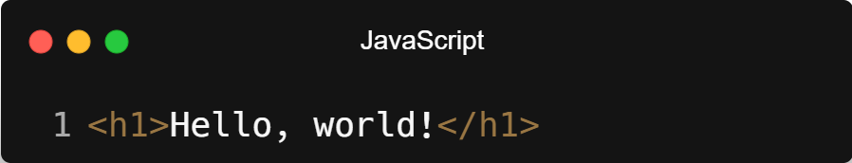
| JSX
JSX stands for JavaScript XML. It's a syntax extension for JavaScript.
It is not HTML. It gets transpiled by Babel into regular React.createElement() function calls.
JSX (JavaScript XML) lets you write HTML-like code inside JavaScript — used in React to describe what the UI should look like.
Syntax :
...directly inside your JavaScript code — instead of using document.createElement() or other complex JS methods.

Slide 11
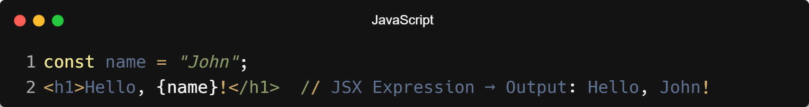
| JSX Expressions
Expressions in JSX are snippets of JavaScript that you can embed inside curly braces {} to make your UI dynamic.
Example :
You can use:
Variables: {name}
Math: {2 + 2}
Functions: {getUserName()}
Conditionals (ternary): {isLoggedIn ? "Logout" : "Login"}

Slide 12
| JSX Syntax Rules
Feature | Example
HTML + JS mix | <h1>Hello {name}</h1>
Curly braces for JS | <p>Total: {price * quantity}</p>
One root element | Must return one parent tag
Use className | <div className="box">...</div>
Use htmlFor | <label htmlFor="email">Email</label>

Slide 13

| Check Your Understanding
Question : What is JSX?
Options : a) A different name for JavaScript.
b) A templating language that is completely separate from JavaScript.
c) A syntax extension for JavaScript that looks like HTML.
d) A method for querying the DOM.
Answer : c) A syntax extension for JavaScript that looks like HTML.
Explanation:
JSX allows you to write HTML-like syntax directly within your JavaScript code, making it easier to visualize and create the structure of your UI components.

Slide 14
| Check Your Understanding
Question : What is the primary advantage of the Virtual DOM over the Real DOM?
Options : a) It is more secure.
b) It can be styled directly with CSS.
c) It is a lightweight copy, and updating it is much faster than updating the Real DOM directly.
d) It works without JavaScript.
Answer : c) It is a lightweight copy, and updating it is much faster than updating
the Real DOM directly.
Explanation:
Manipulating the Real DOM is slow. React creates a Virtual DOM, calculates the most efficient way to apply changes (a process called "diffing"), and then updates the Real DOM only with the necessary changes, leading to better performance.

Slide 15
| Check Your Understanding
Question : How do you embed a JavaScript variable, say userName, inside a JSX element?
Options : a) <h1>(userName)</h1>
b) <h1>${userName}</h1>
c) <h1>{{userName}}</h1>
d) <h1>{userName}</h1>
Answer : d) <h1>{userName}</h1>
Explanation:
Curly braces {} are used in JSX to "escape" back into JavaScript. Any valid JavaScript expression can be placed inside them.

Slide 16
| References
MDN Web Docs : Comprehensive and official documentation for JS. 🔗https://developer.mozilla.org/en-US/docs/Web/JavaScript
W3Schools – JS Tutorial : Beginner-friendly JS tutorials with examples and interactive editors. 🔗 https://www.w3schools.com/js/
react.dev - A comprehensive, tutorial-style website that deeply explores core React concepts, including components, state, effects, and hooks, through interactive examples and in-depth explanations.
🔗https://react.dev/

Slide 17
Thanks
For
Watching
Course - Web Development - II
welcome@krmangalam.edu.in
Sohna Road,Gurugram,Haryana 122103

